Slide 1


SAP UI5 & FIORI with OData TRAINING
Anubhav Oberoy & Nishan Nainsukha
Day – 15

Slide 2

Agenda – Day 15
Introduction to Postman
Building CreateEntity(POST) Method
Implementing the delete and update method
Testing the Create Method at Sap Gateway client
Function Import

Slide 3
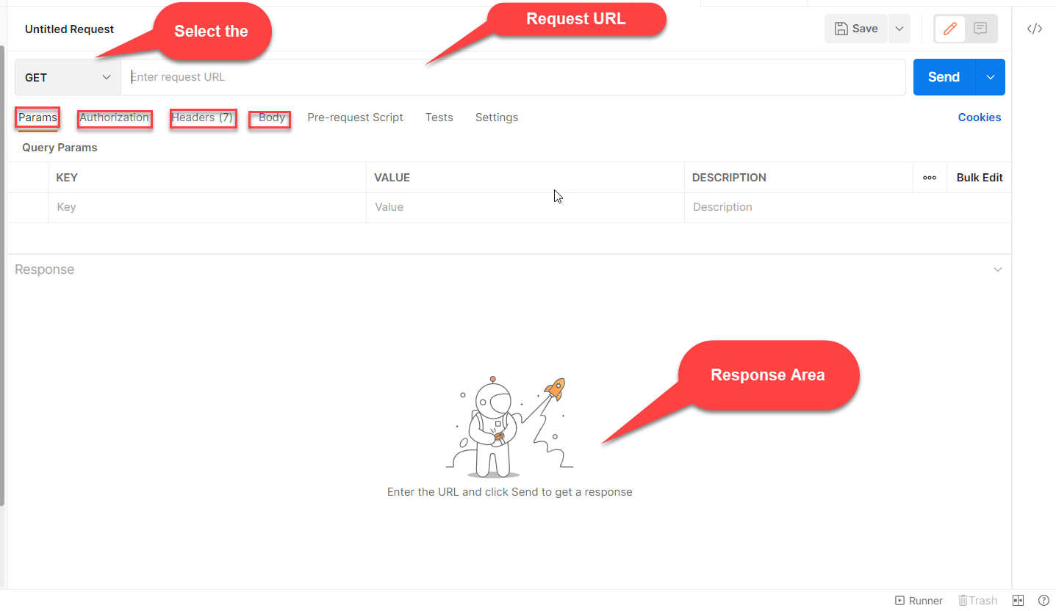

Postman
Postman is an API platform for building and using APIs. Postman simplifies each step of the API lifecycle and streamlines collaboration so you can create better APIs—faster.

Slide 4
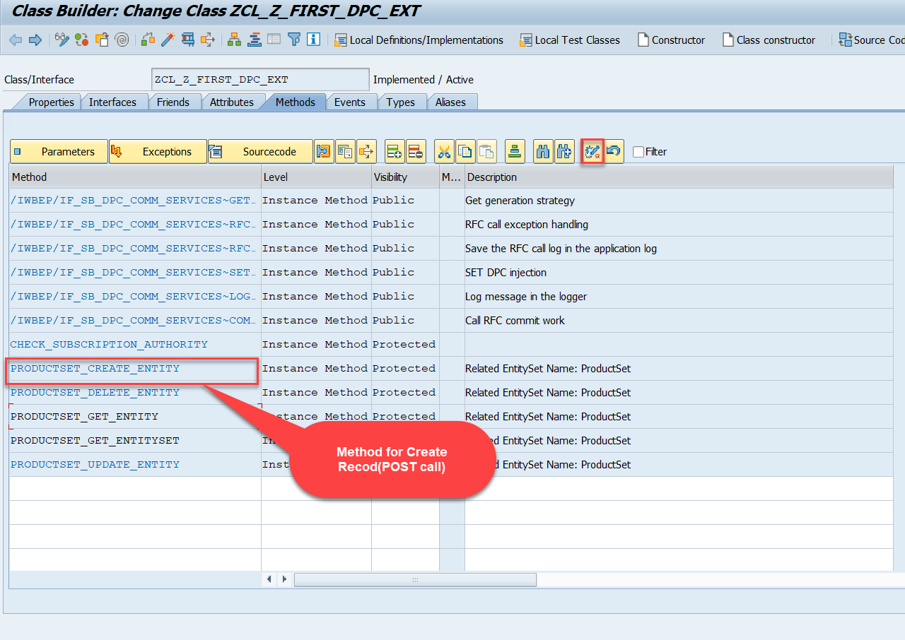
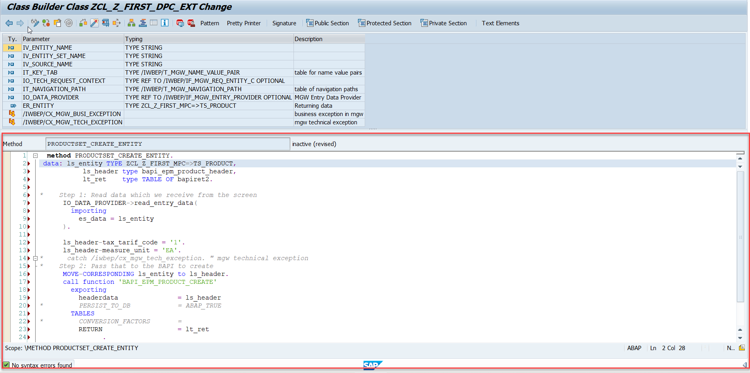
Building CreateEntity(POST) Method
Go to DPC Extension of over service and redefine the method PRODUCTSET_CREATE_ENTITY

Slide 5
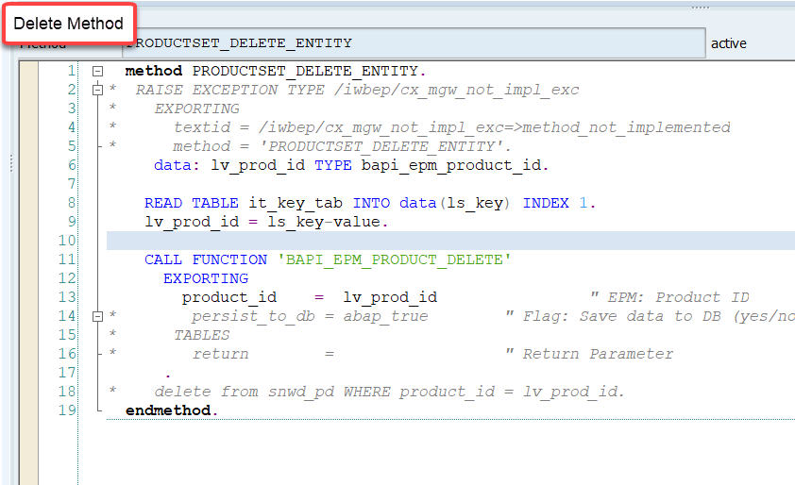
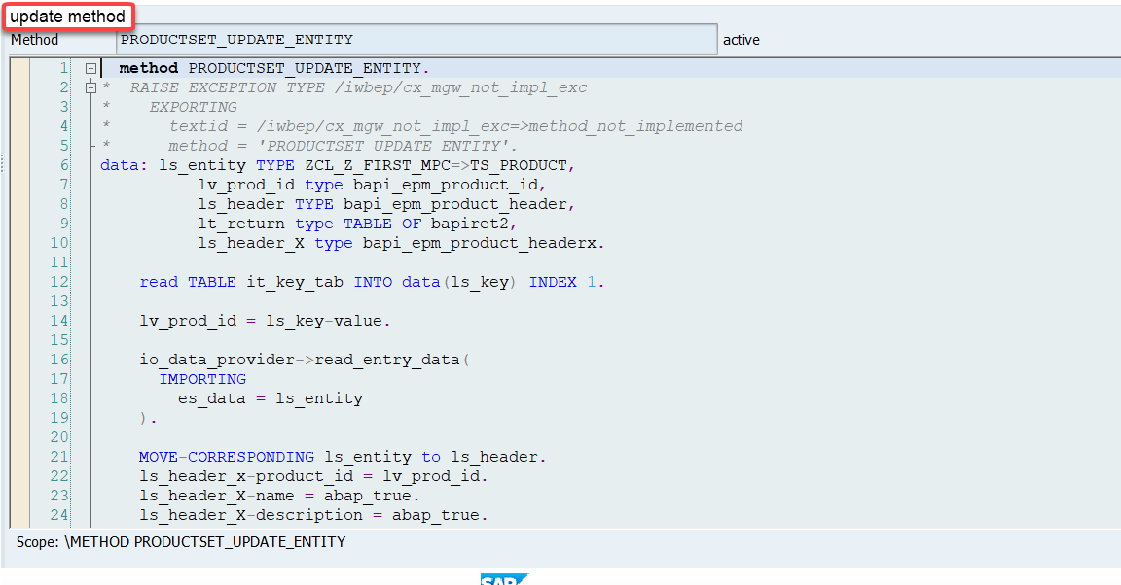
Implementing the delete and update method
We can implement the delete and update method in the cross-ponding dpc extension classes

Slide 6
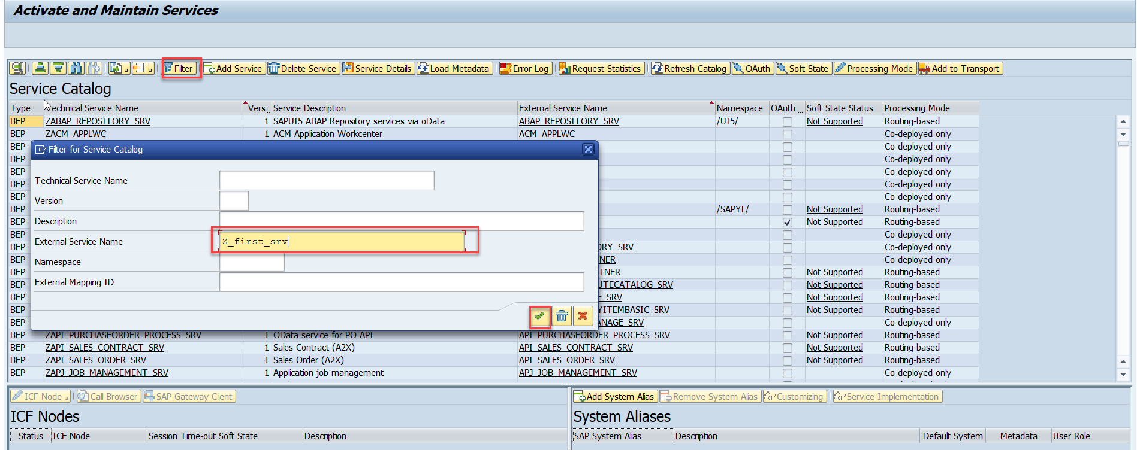
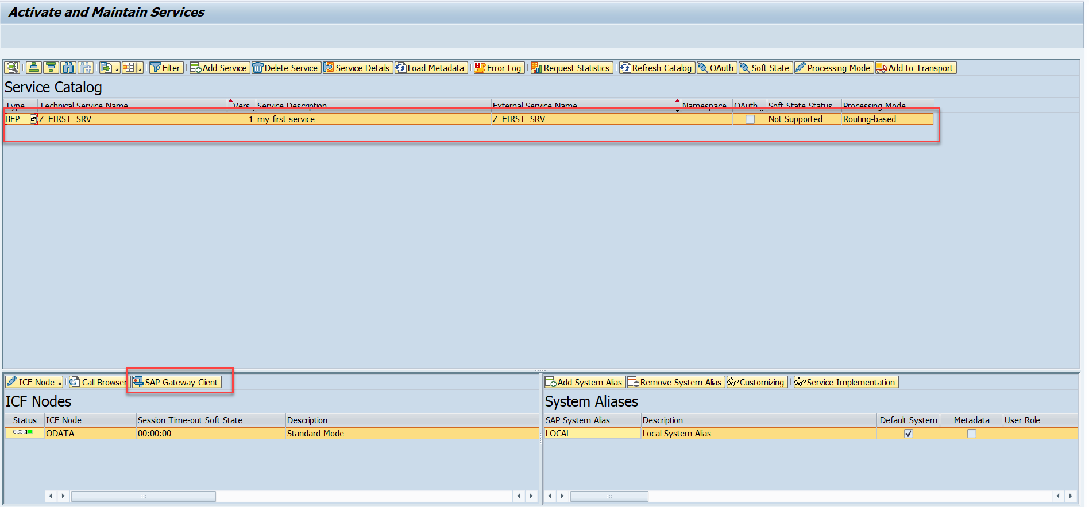
Testing the Create Method at Sap Gateway client
Step:1 Go to sap service maintance(tcode- /iwfnd/maint_service) and search for the service and then select the service and click on the sap gateway client

Slide 7
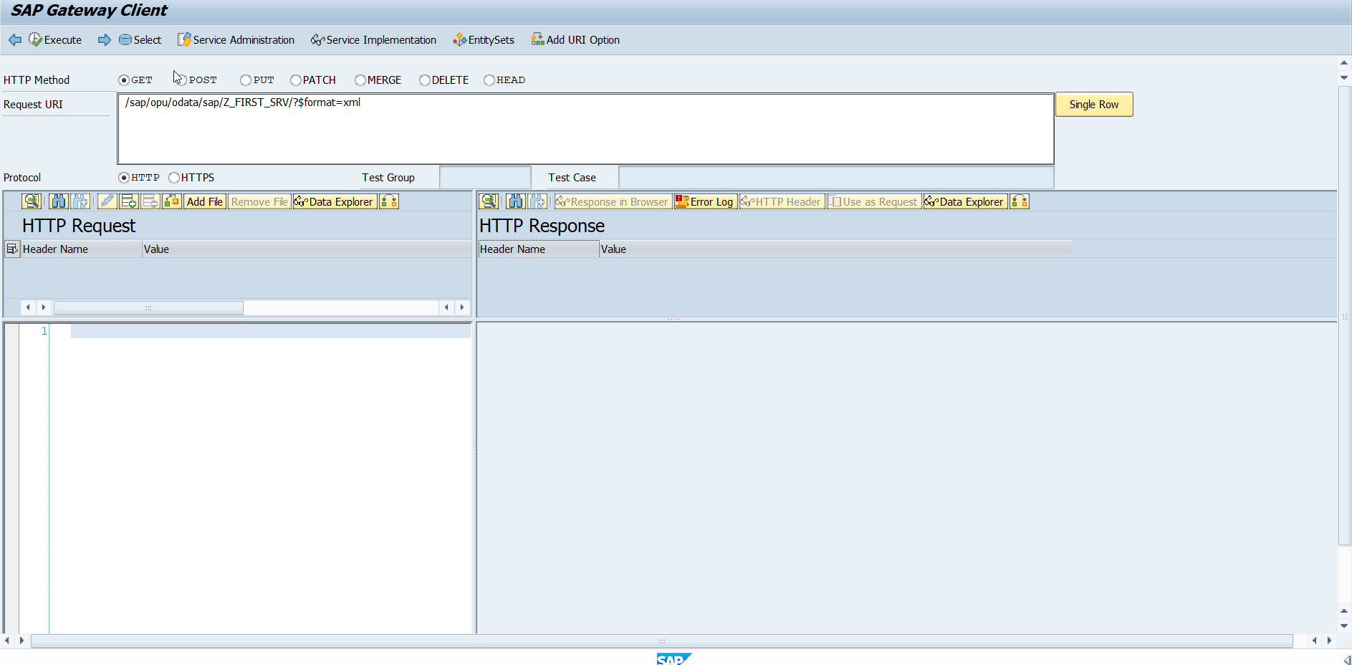
Testing the Create Method at Sap Gateway client
Step:2 Go to sap service maintance(tcode- /iwfnd/maint_service) and search for the service and then select the service and click on the sap gateway client

Slide 8
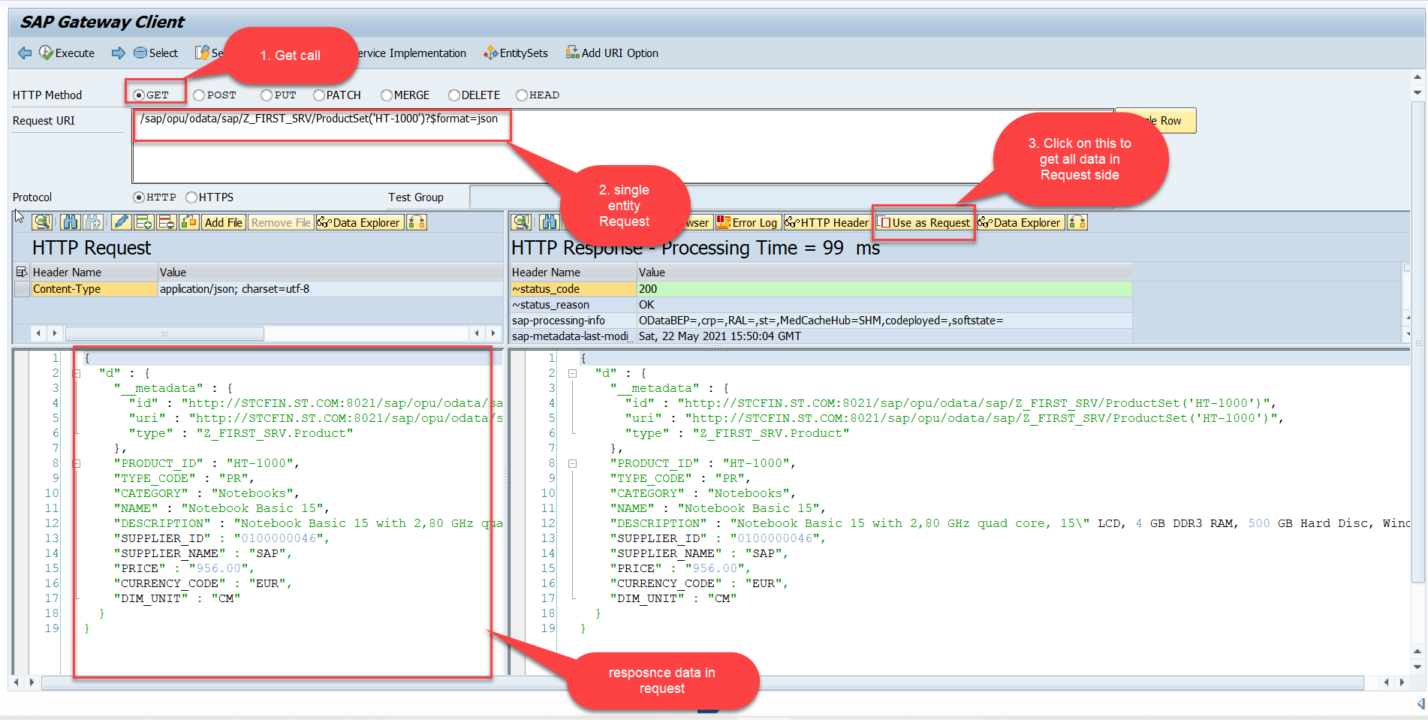
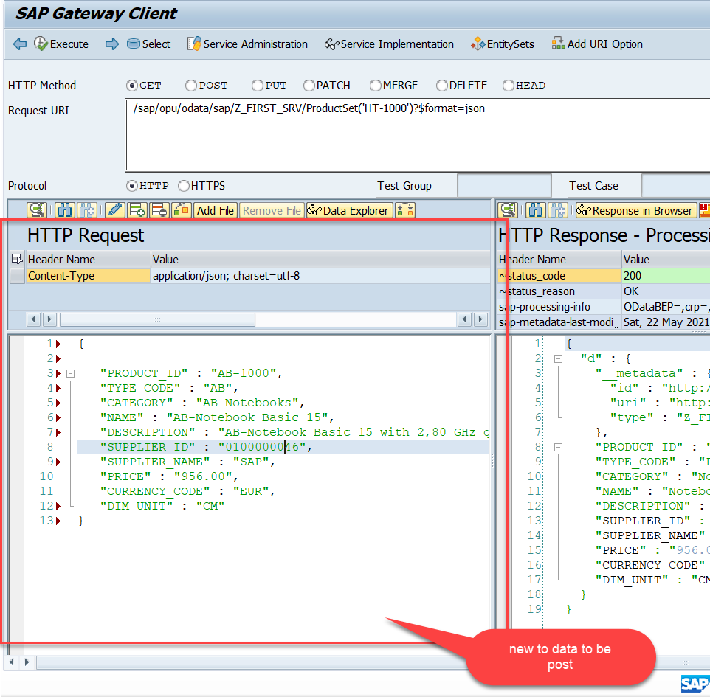
Testing the Create Method at Sap Gateway client
Step:3 Perform a getEntity in the Product set to get the payload to post (/sap/opu/odata/sap/Z_FIRST_SRV/ProductSet('HT-1000')?$format=json) and then clean the data and modify the payload as new.

Slide 9
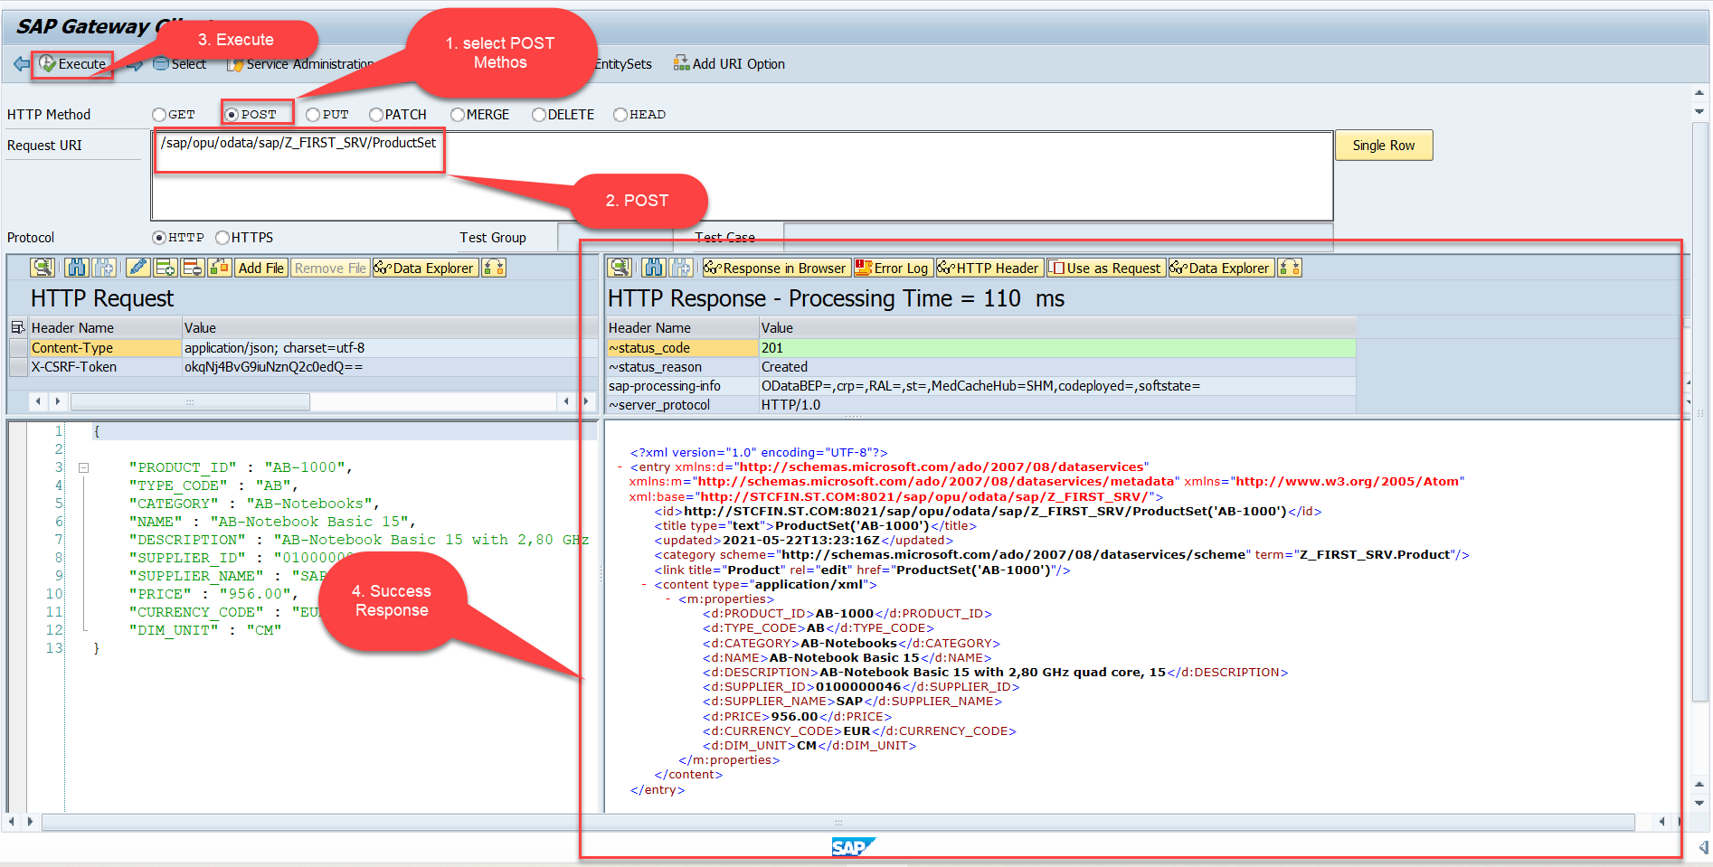
Testing the Create Method at Sap Gateway client
Step:4 send the post request at (/sap/opu/odata/sap/Z_FIRST_SRV/ProductSet)
You can check the saved data in database table (tcode – se11)

Slide 10
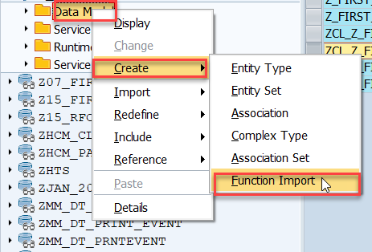
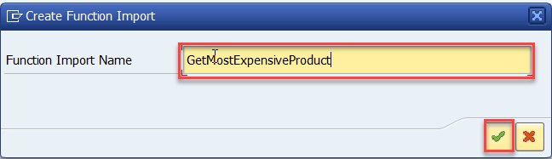
Function Import
At times, we need to implement the logic inside of OData which is not a direct CRUD operation e.g. calling a workflow, calling a BAPI which does some processing, Sending request to another server and can be invoked by the HTTP methods GET or POST .
For example: we can create the function import to GetMostExpensiveProduct in our Product set by the Category.
Step1: Right click the Data Model folder, and select Create and then select Function Import. Create Function Import dialog opens

Slide 11
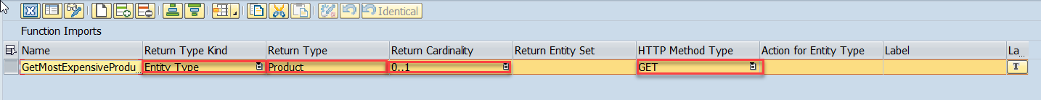
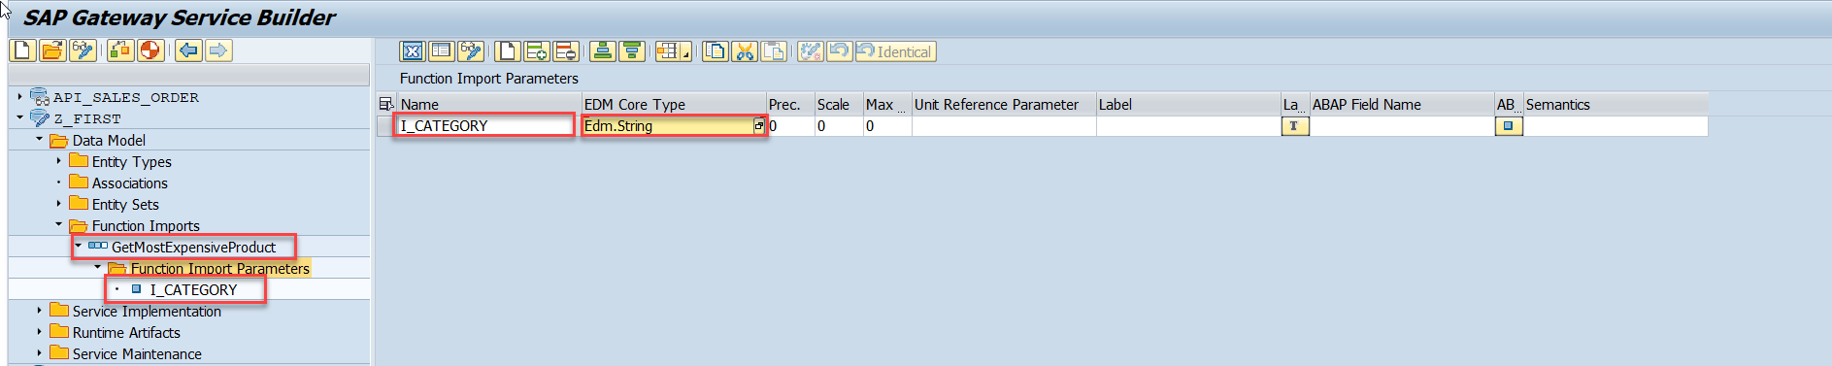
Function Import
Step2: Enter return type kind, return type, return cardinality & HTTP method Type
Step3: Giving function import parameters (I_CATEGORY)

Slide 12
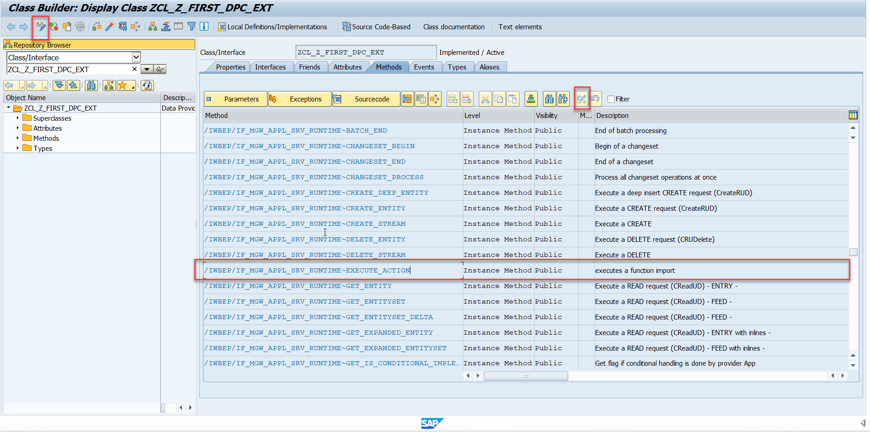
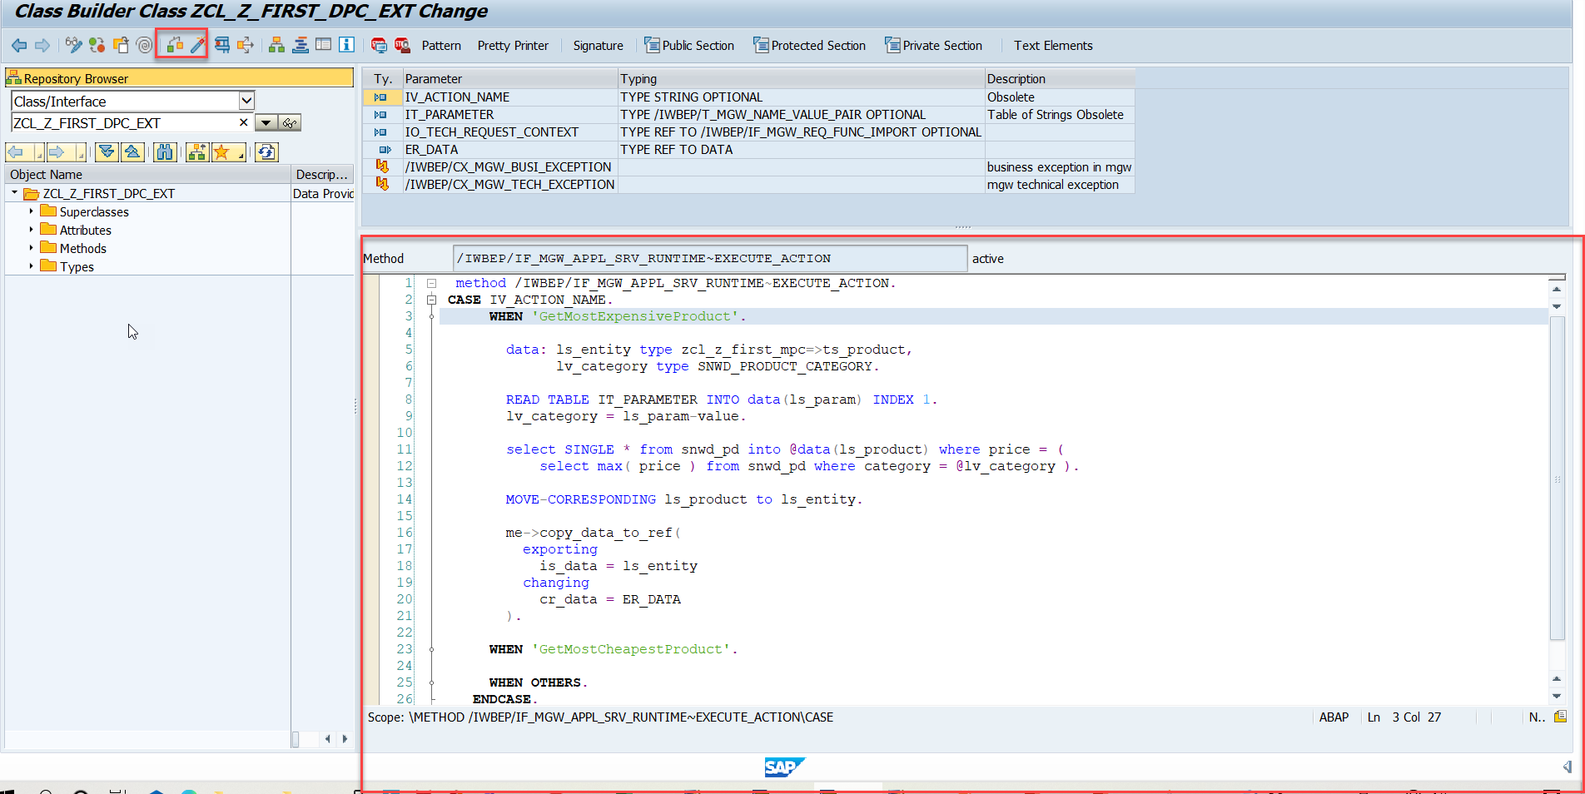
Function Import
Step4: Go to DPC Extension and search for the method--/IWBEP/IF_MGW_APPL_SRV_RUNTIME~EXECUTE_ACTION and redefine the class method

Slide 13

Exercise
Create a new Entity Set Supplier
Get the supplier header from BAPI_EPM_BP
Perform GetEntitySet and GetEntity

Slide 14

End of Day 15

Slide 15

Questions

Slide 16

Anubhav Oberoy

Slide 17


We’re committed to empower you to be
Most Desirable Resource
through powerful training solutions.
We build the workforce of the future.
250+
Corporate Clients
30,000+
Learners Trained
25000+
Learners Placed
FREE WEBINARS
Sign up for free webinars with industry experts every fortnight!
Enroll Now!
Contact us today!
https://anubhavtrainings.com/

Slide 18




More from AnubhavTrainings.com

